Slide 1
HOW TRANSFORMERS WORK IN NLP
Machine Learning in Natural Language Processing has traditionally been performed with recurrent neural networks. Recurrent, here, means that when a sequence is processed, the hidden state (or ‘memory’) that is used for generating a prediction for a token is also passed on, so that it can be used when generating the subsequent prediction.
A recurrent neural network (RNN) is a class of artificial neural networks where connections between nodes form a directed graph along a temporal sequence. This allows it to exhibit temporal dynamic behavior. Derived from feedforward neural networks, RNNs can use their internal state (memory) to process variable length sequences of inputs.
Recurrent networks have been around for some time. One of the first ones was a simple or vanilla recurrent network, or vanilla RNN. As you can see, upon generating a prediction, the updated hidden state is passed to itself, so that it can be used in any subsequent prediction. When unfolded, we can clearly see how this works with a variety of input tokens and output predictions.

Slide 2
DRAWBACKS OF RNNS
Because of the way in which hidden states were passed, RNNs were highly sensitive to the vanishing gradients problem. Especially with longer sequences, the chain of gradients used for optimization can be so long that actual gradients in the first layers are really small. In other words, as with any network struck by vanishing gradients, the most upstream layers learn almost nothing.
The same is true for memory: the hidden state is passed to the next prediction step, meaning that most of the contextual information available is related to what the model has seen in the short term. With classic RNNs, models therefore face a long-term memory issue, in that they are good at short-term memory but very bad at longer-term memory.
Processing happens sequentially. That is, each word in a phrase has to be passed through the recurrent network, after which a prediction is returned. As recurrent networks can be intensive in terms of the computational requirements, it can take a while before an output prediction is generated. This is an inherent problem with recurrent networks.

Slide 3
LSTM IN NLP
Fortunately, in the 2010s, Long Short-Term Memory networks (LSTMs, top right) and Gated Recurrent Units (GRUs, bottom) were researched and applied to resolve many of the three issues above. LSTMs in particular, through the cell like structure where memory is retained, are robust to the vanishing gradients problem. What’s more, because memory is now maintained separately from the previous cell output (the flow in the LSTM image below, for example), both are capable of storing longer-term memory.

Slide 4
WHY TRANSFORMERS
Transformer, which is capable of maintaining the attention mechanism while processing sequences in parallel: all words together rather than on a word-by-word basis.
This architecture has obliterated the final issue from the three mentioned above, namely that sequences have to be processed sequentially, incurring a lot of computational cost. With Transformers, parallelism has become real.
As we shall see in different articles, Transformer based architectures come in different flavors. Based off the traditional Transformer architecture, researchers and engineers have experimented significantly and brought about changes. However, the original Transformer architecture looks as follows:

Slide 5
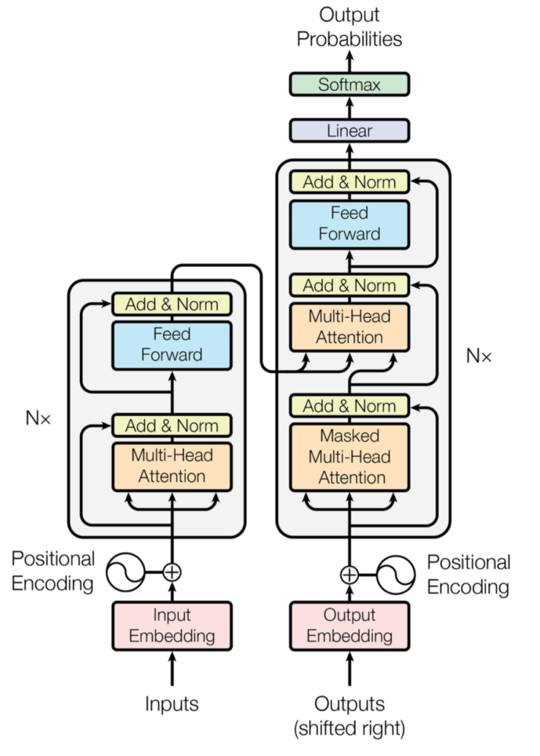
MODEL ARCHITECTURE- TRANSFORMERS
An encoder segment, which takes inputs from the source language, generates an embedding for them, encodes positions, computes where each word has to attend to in a multi-context setting, and subsequently outputs some intermediary representation.
A decoder segment, which takes inputs from the target language, generates an embedding for them with encoded positions, computes where each word has to attend to, and subsequently combines encoder output with what it has produced so far. The outcome is a prediction for the next token, by means of a Softmax and hence argma class prediction (where each token, or word, is a class).

Slide 6
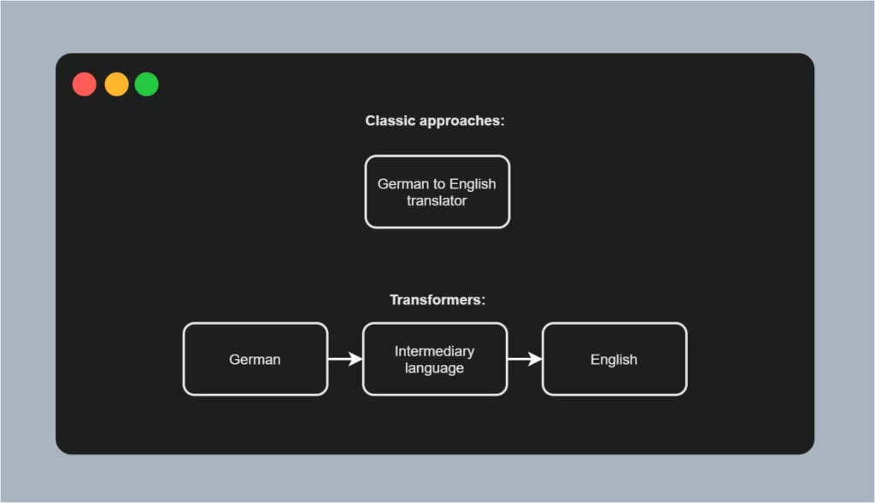
Difference between Transformers & Classical Approaches

Slide 7
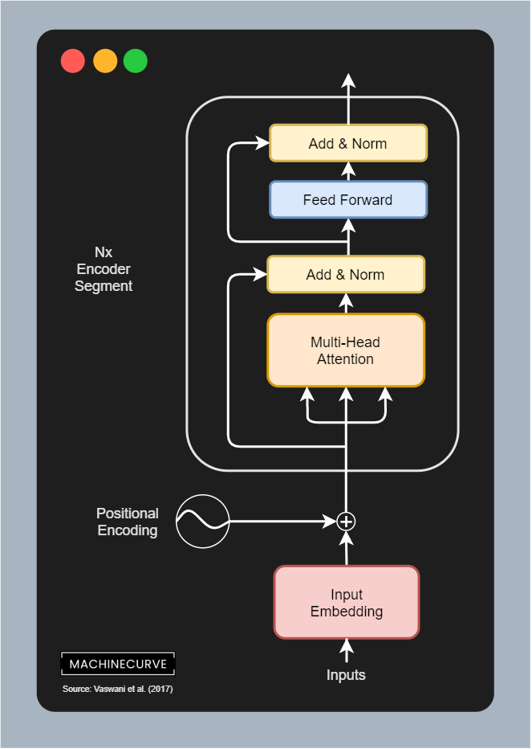
HOW TRANSFORMERS WORK IN NLP
The encoder segment is composed of a couple of individual components:
Input Embeddings, which convert tokenized inputs into vector format so that they can be used.
Positional Encodings, which slightly change the vector outputs of the embedding layer, adding positional information to these vectors.
The actual encoder segment, which learns to output an attended representation of the input vectors, and is composed of the following sub segments:
The multi-head attention segment, which performs multi-head self-attention, adds the residual connection and then performs layer normalization.
The feed forward segment, which generates the encoder output for each token.
The encoder segment can be repeated N times.

Slide 8
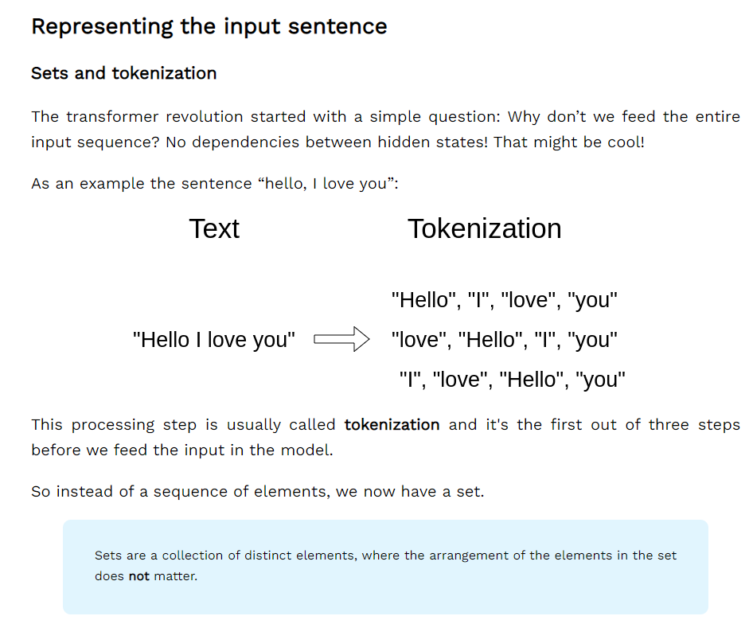
REPRSENTING INPUT SEQUENCE

Slide 9
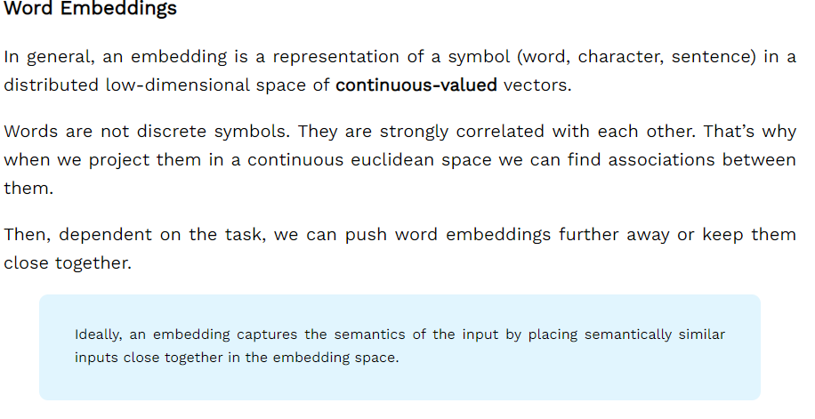
HOW TRANSFORMERS WORK IN NLP

Slide 10
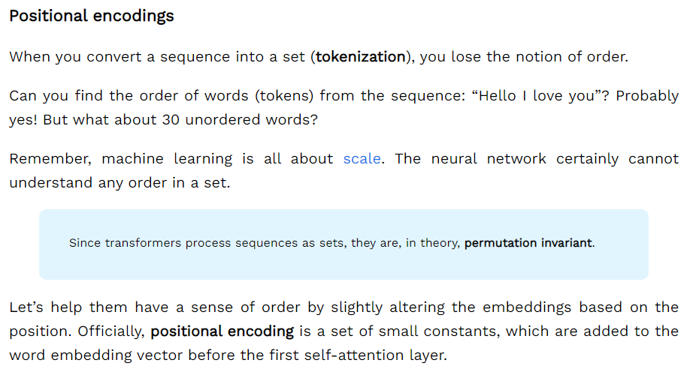
HOW TRANSFORMERS WORK IN NLP

Slide 11
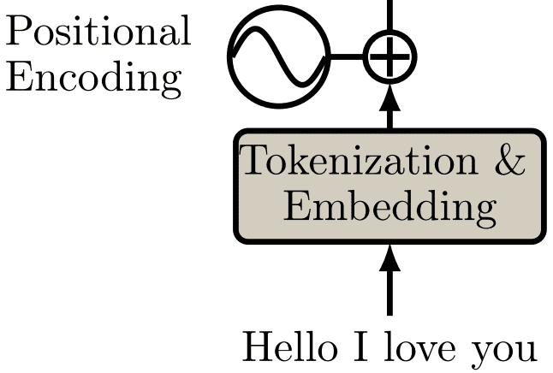
HOW TRANSFORMERS WORK IN NLP

Slide 12
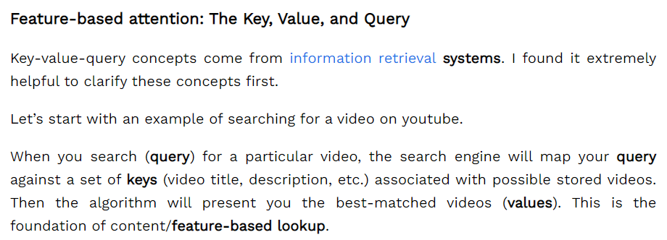
HOW TRANSFORMERS WORK IN NLP

Slide 13
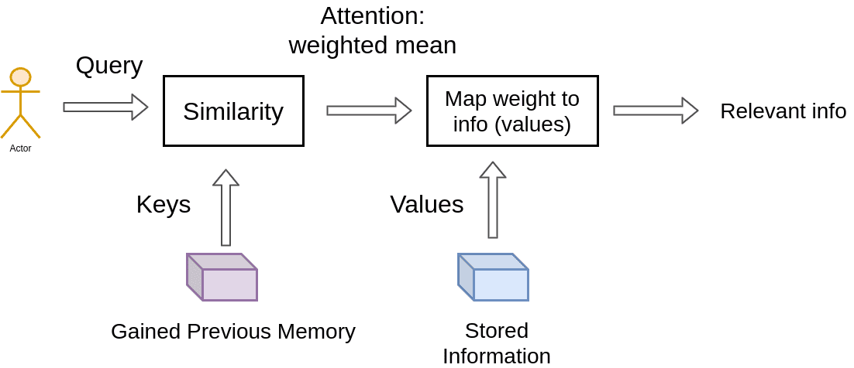
HOW TRANSFORMERS WORK IN NLP

Slide 14
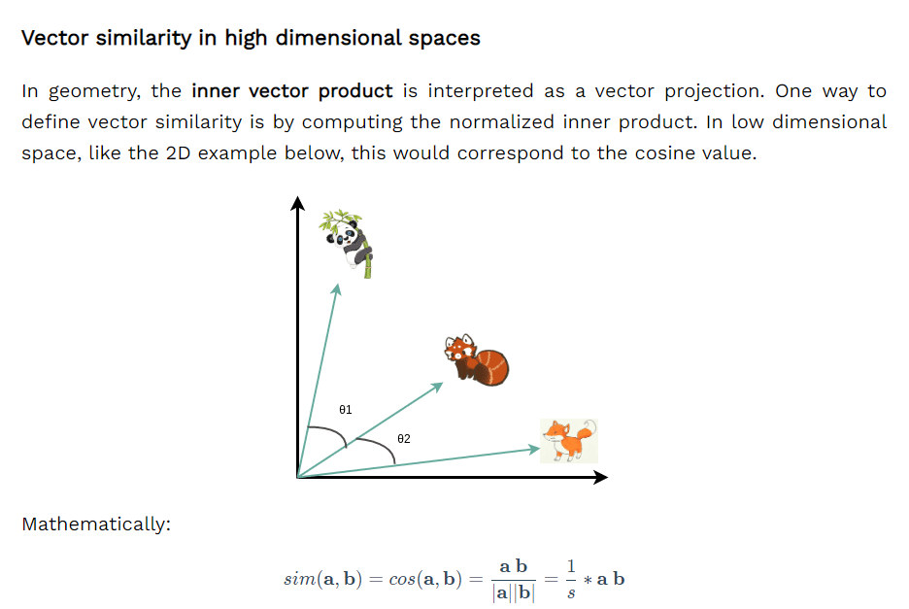
HOW TRANSFORMERS WORK IN NLP

Slide 15
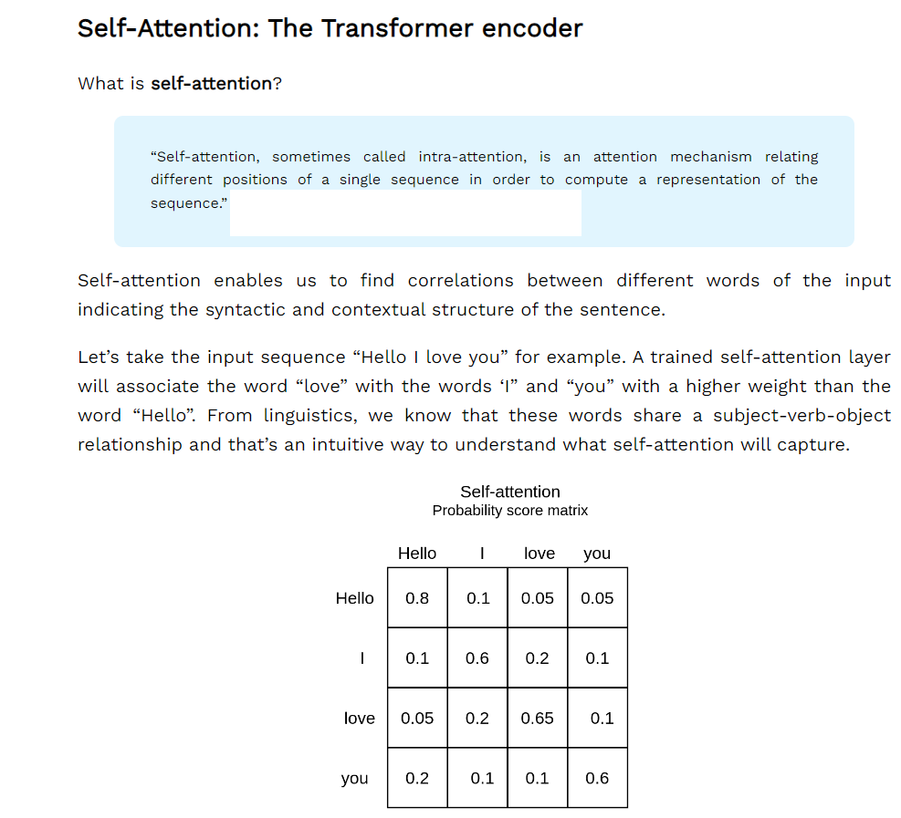
HOW TRANSFORMERS WORK IN NLP

Slide 16
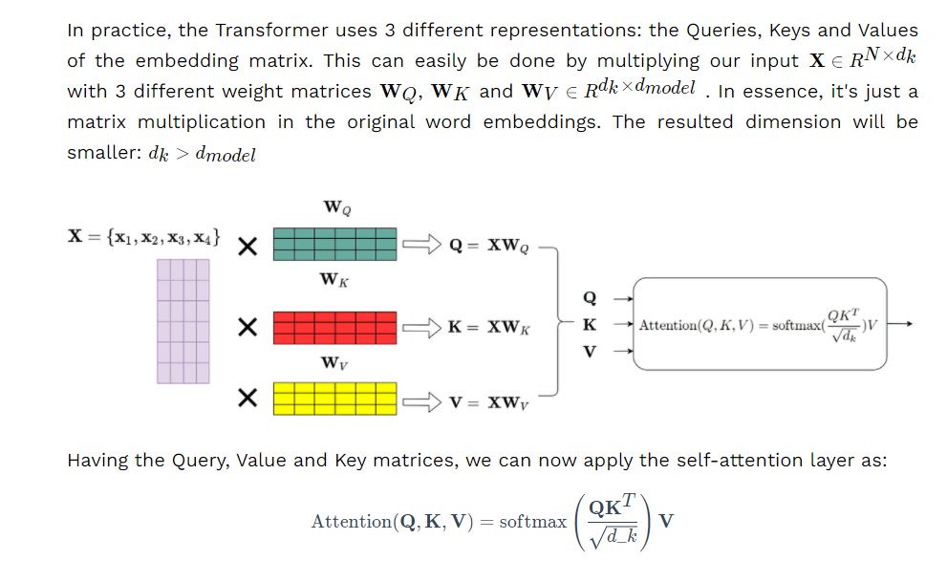
HOW TRANSFORMERS WORK IN NLP

Slide 17
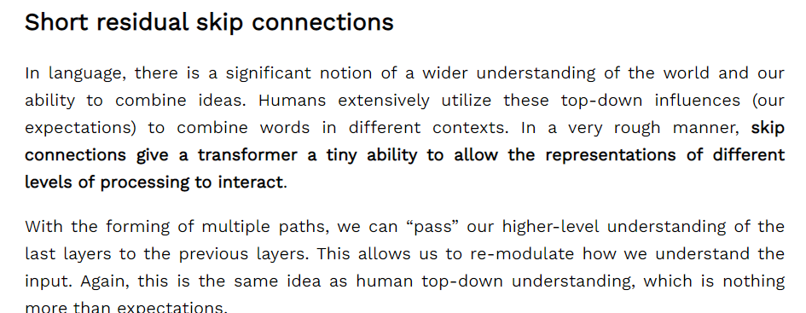
HOW TRANSFORMERS WORK IN NLP

Slide 18
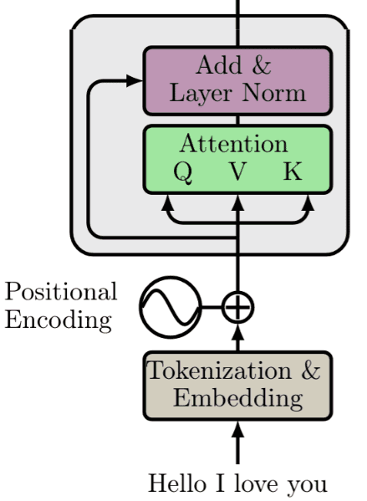
HOW TRANSFORMERS WORK IN NLP

Slide 19
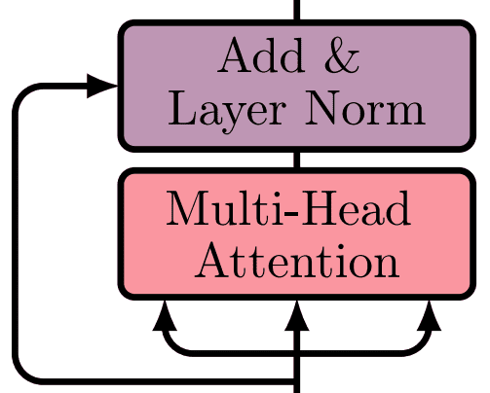
HOW TRANSFORMERS WORK IN NLP

Slide 20
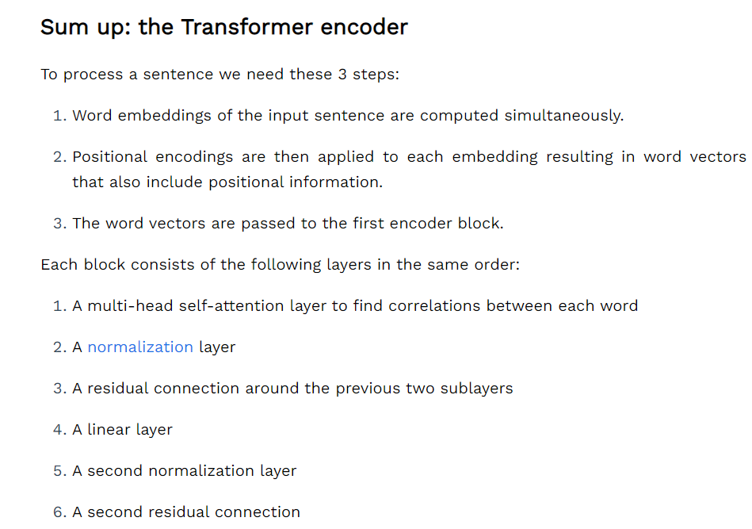
HOW TRANSFORMERS WORK IN NLP

Slide 21
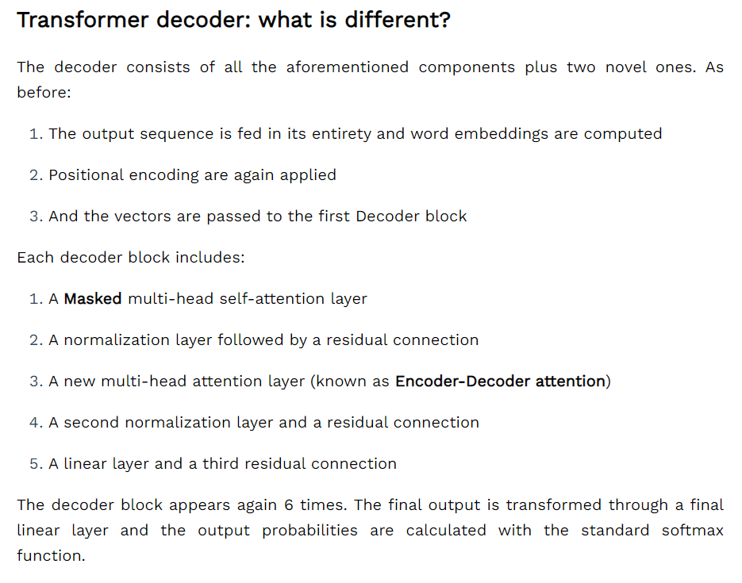
HOW TRANSFORMERS WORK IN NLP

Slide 22
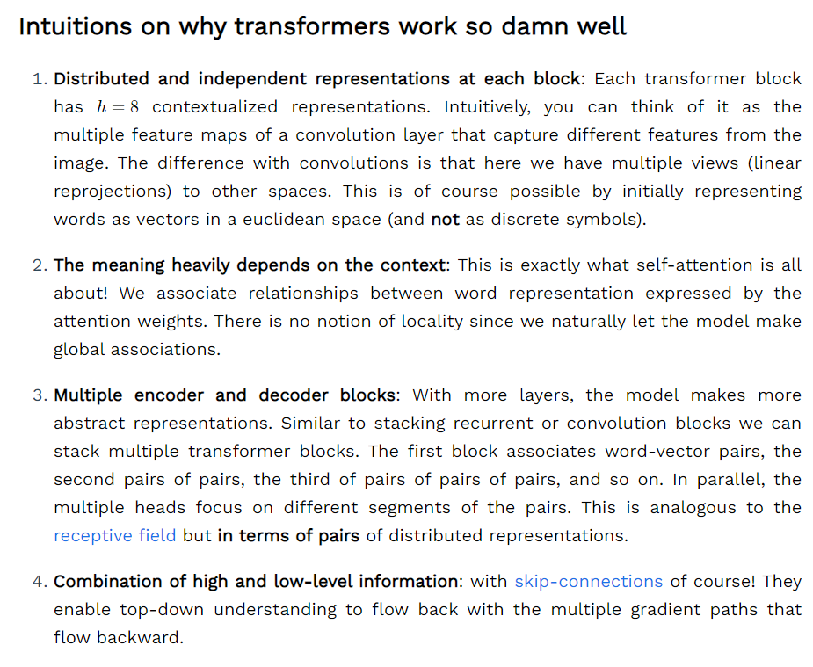
HOW TRANSFORMERS WORK IN NLP

